Slide 1
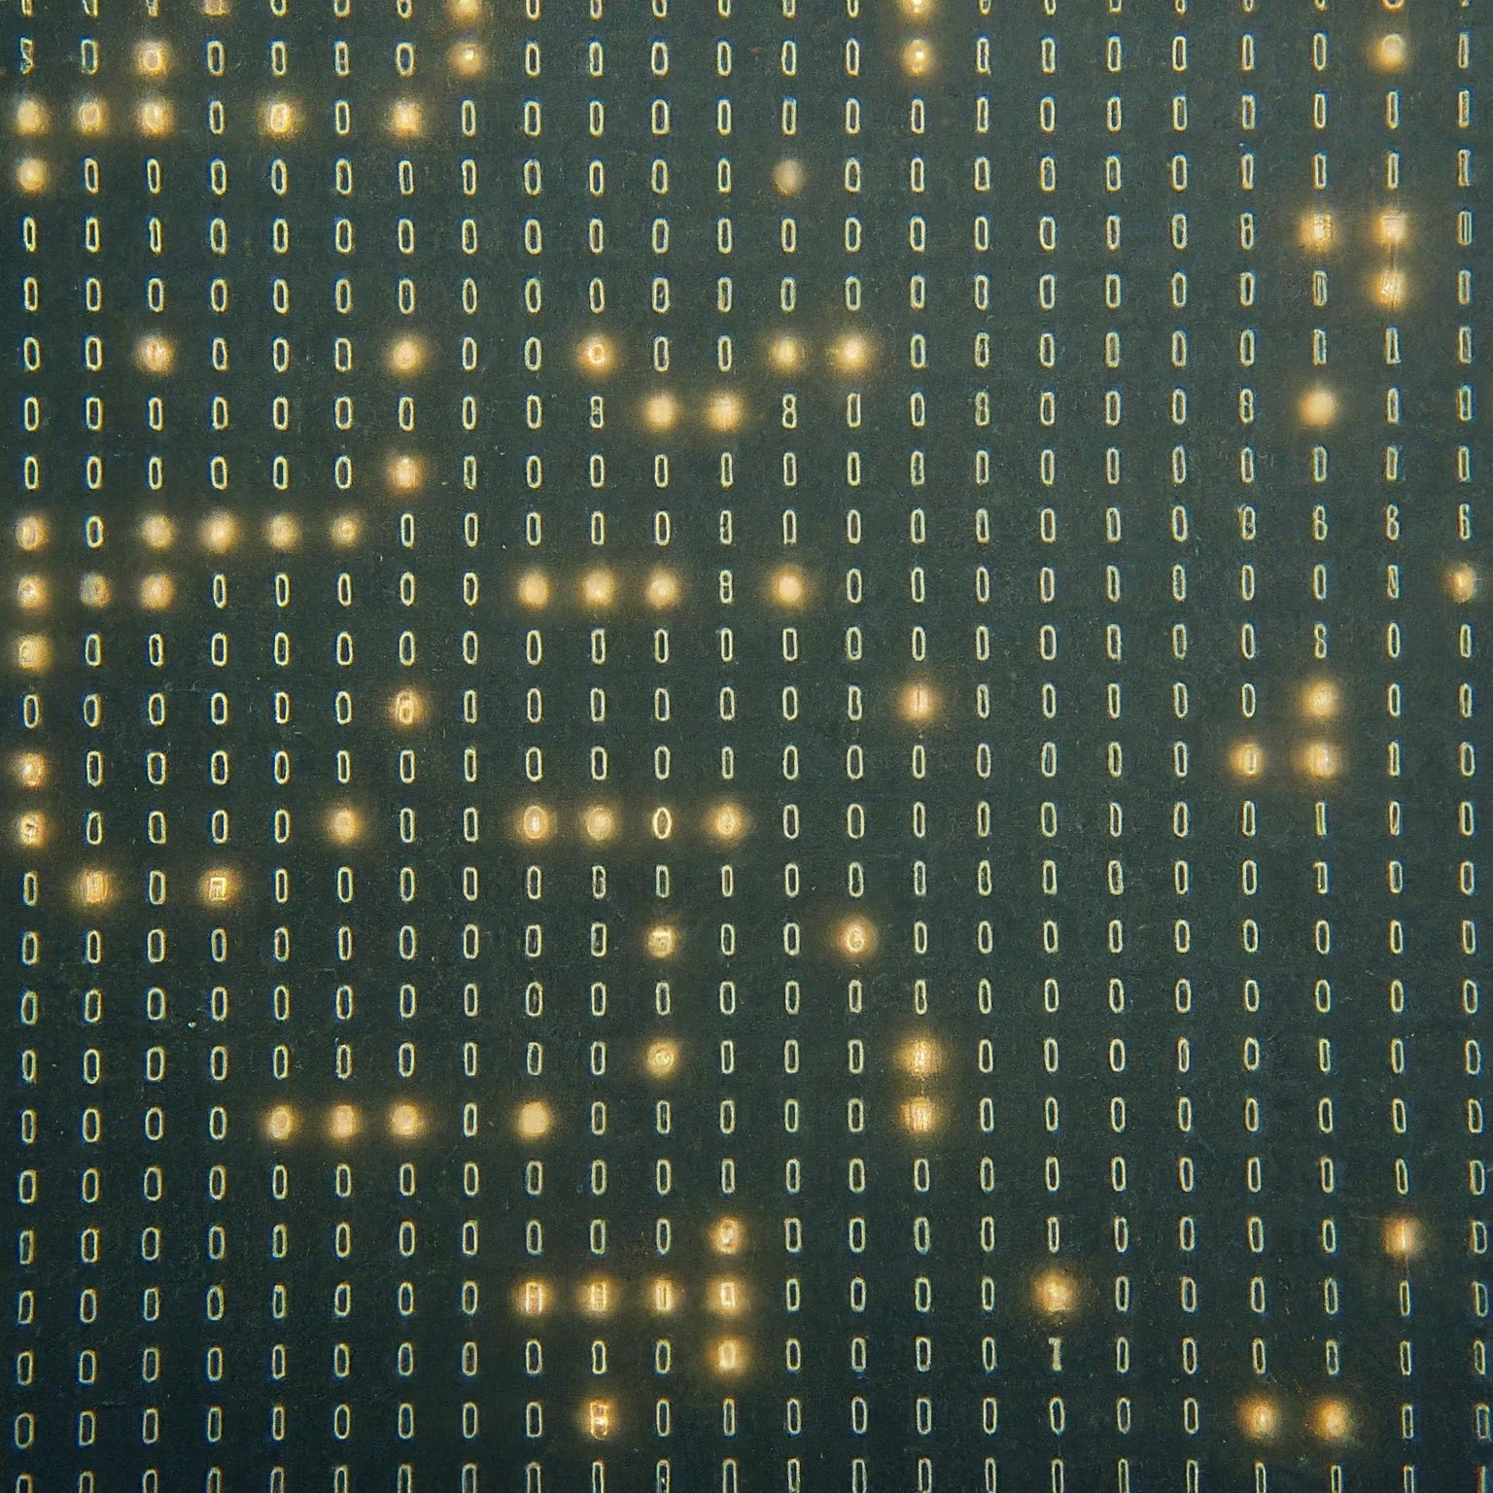
QUANTUM

Slide 2

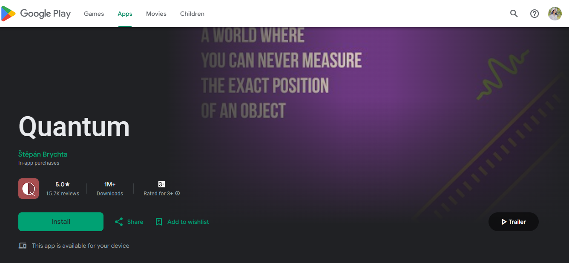
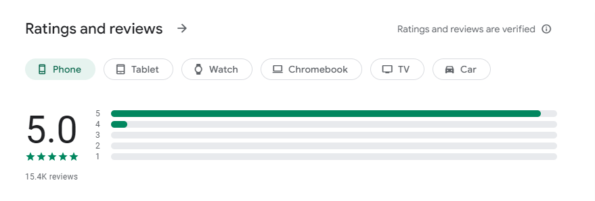
QUANTUM
https://play.google.com/store/apps/details?id=brychta.stepan.quantum_en&pcampaignid=web_share

Slide 3


You can learn quantum from this app
Interactive lessons
quizzes
Notes

Slide 4
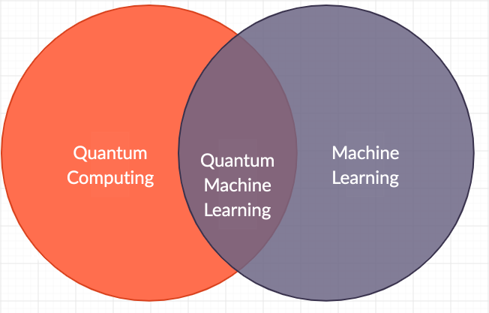
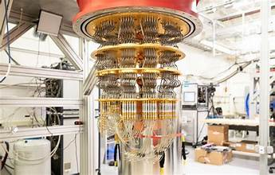
What is QUANTUM?
Quantum mechanics, often simply referred to as "quantum," is a fundamental theory in physics that describes the behavior of matter and energy at very small scales, typically on the order of atoms and subatomic particles. It provides a framework for understanding the properties of particles such as electrons, photons, and other fundamental constituents of the universe.

Slide 5
The whole world is talking about quantum
Here are some potential reasons why someone might create or use such an app:
Education and Learning:
Community Building
Expert Q&A
Interactive Simulations:

Slide 6

Tim O'Reilly said,
What new technology does it create new opportunities to do a job that customers want done

Slide 7

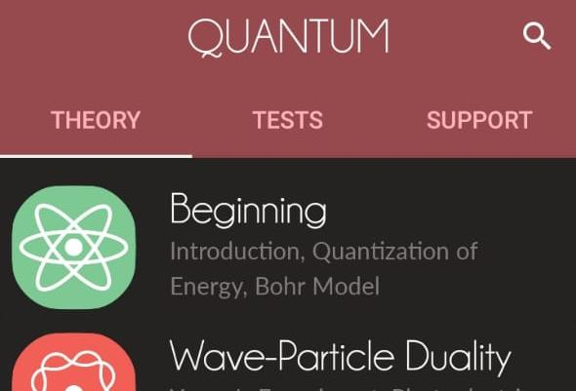
About THIS APP
This app help to learn basic phenomena of quantum physics
Through this app we can test our knowledge
Here there are 3 main parts of this app
They are,
Theory
Tests
Support

Slide 8
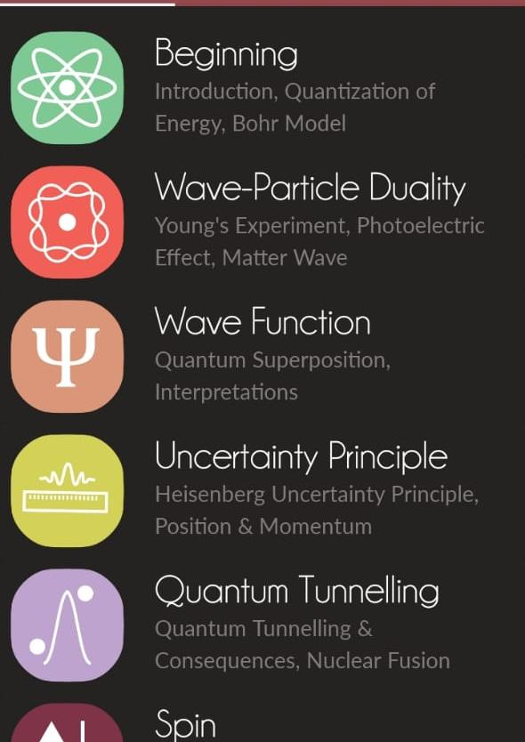
Inside the app
In Theory part of this app contains the basic knowledge about Quantum.
Here there are sub topics for the easy understand for the beginners.
Here they can go through the each topic they want to know and get the idea about it.
Ex:- There are sub topics called Beginning, Wave Function, Spin, Quantum Computers etc

Slide 9
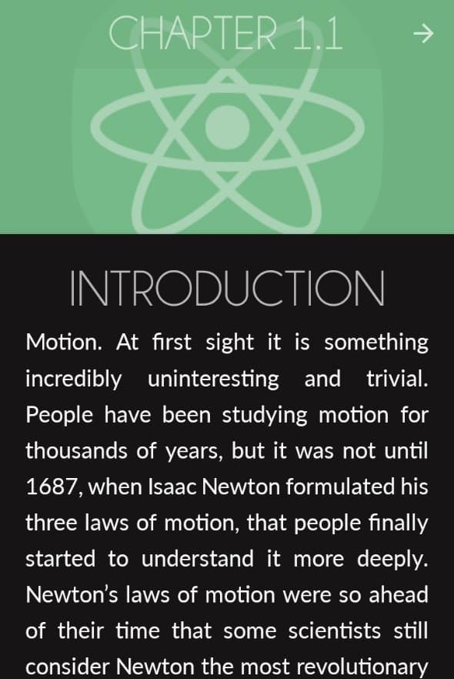
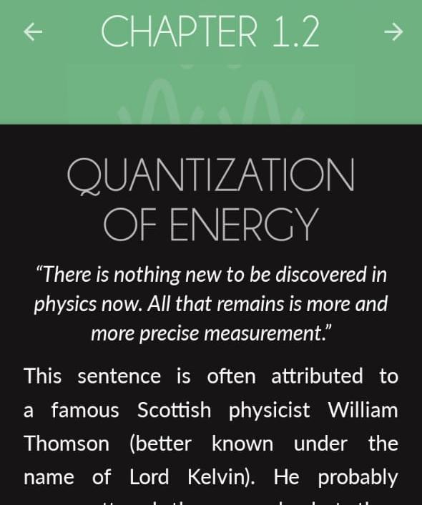
In the Beginning topic it has two subtopics called Introduction to quantum and Quantization of Energy
Ex:- In the begging part they give brief introduction about Quantum. And the second part describe the figures of energy.

Slide 10
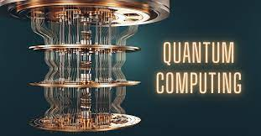
Value of the Application
Quantum application have the potential to revolutionize various fields, including quantum computing.

Slide 11
Advantages of the App
Algorithm Development
Error Correction and Mitigation
Machine Learning and AI
Simulation and Modelling
Optimization and Search

Slide 12
Conclusion
In conclusion, the development of a quantum app for learning quantum computing represents an innovative approach to education in this rapidly advancing field. By providing an interactive platform, users can engage with complex concepts in a hands-on manner, facilitating deeper understanding and skill development. As quantum computing continues to evolve, accessible learning tools like this app will play a crucial role in preparing the next generation of quantum engineers and researchers.

Slide 13

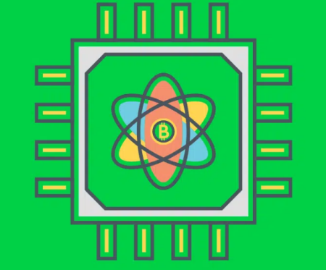
Quantum Apps quantum android app Quantum Ai Crypto Trading App
Another great resource for beginners is the Quantum Country app. It offers interactive tutorials and exercises to help learners understand fundamental quantum computing concepts in an intuitive way. It's designed to gradually introduce concepts and build upon them, making it accessible for those new to quantum computing.

Slide 14
Any Questions?

Slide 15
Group members
GADSE231F – 029 T.K.Nethmi
GADSE231F – 068 Samidi Ruwanima
GADSE231F – 069 Kaweesha Ganagani
GADSE231F – 072 Rashmi Dulmini

Slide 16
Thank You!...

